Slide 1
Comparison of Sudoku Solving Algorithms

Slide 2
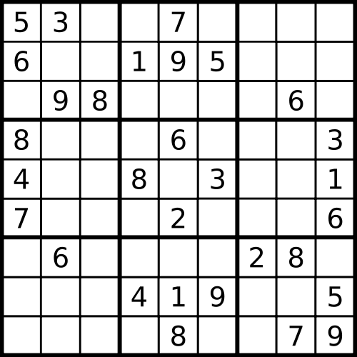
Introduction: What is Sudoku?
Row
Column
3x3 Box

Slide 3
Aims / Objectives
Aim: Create a test bed that takes a range of sudoku solving algorithms and compares them using a range of difficulty of puzzles.
Objectives:
Explore current methods of sudoku solving.
Establish test data that would allow for comparison of different algorithms.
Select algorithms for sudoku solving that are to be compared.
Develop test bed to allow comparison of algorithms.
Evaluate implemented sudoku algorithms on their effectiveness at solving a rank of complexities of puzzle.

Slide 4
Research so far
Backtracking
Brute-force algorithm
Cycles through numbers, until rule broken
Stochastic Algorithms
randomly assign numbers
Calculate Errors
Shuffle inserted numbers

Slide 5
Timeline
2019
Sep
Oct
Nov
Dec
2020
Feb
Mar
Apr
May
2020
Researching Project Idea
Sep 30 - Oct 7
Ethical Approval
Oct 31 - Nov 1
Project Presentation
Oct 30 - Nov 4
Project Proposal
Nov 21 - Nov 29
Project Poster
Mar 20 - Mar 27
Reading Research
Oct 7 - Nov 28
Modelling Algorithms
Nov 18 - Dec 5
Test Bed: First Implementation
Nov 19 - Dec 13
Test bed and test data
Jan 27 - Feb 12
Implementation of Algorithms
Feb 15 - Mar 6
First Dissertation Draft
Mar 7 - Mar 23
Dissertation
Nov 10 - May 1
Notes:
Investigate different stochastic algorithms: randomly assigning numbers to empty cells, shuffle number methods.
Sudoku test bed and sudoku creation research / implementation
Algorithm implementation
Write up
Agile Methodology – adding things incrementally: algorithms 1 at a time, test bed and test data creation

Slide 6
Issues / Risks
Algorithm Complexity
Feasible within timeframe
My own skills
Test bed implementation
Deliver project on time

Slide 7
Questions?

Slide 8
References
https://www-cdf.fnal.gov/~qgliu/Misc/sudoku.html
Animation By Simpsons contributor - Program written in Java, letter images made in Photoshop, CC BY-SA 3.0, https://commons.wikimedia.org/w/index.php?curid=29034832
https://www.officetimeline.com/

